Slide 1
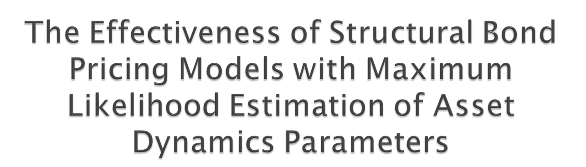
Dale Holborow
Financial Mathematics Major

Slide 2

Every day, companies raise money by issuing corporate bonds.
A bond is an agreement in which a borrower (‘issuer’) receives some dollar amount up front, and agrees to repay the lender (‘investor’) regular interest payments and a lump sum at maturity.
These is a risk that the investor will not be able to recoup all their investment should the issuing company go broke.

Slide 3
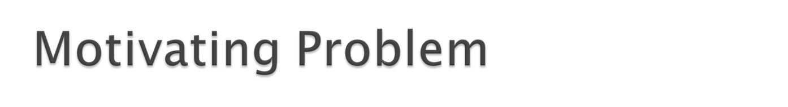
Depending on how likely it is that an issuer is unable to repay their loan, lenders will demand higher returns on their investment as compensation.
The question of how to arrive at a fair price for a risky corporate bond is still unresolved.

Slide 4
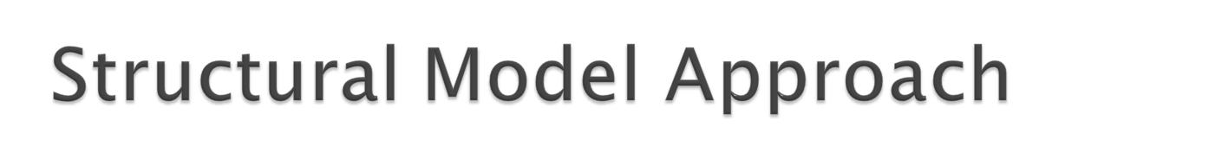
‘Contingent claims analysis’, uses financial statements and market observations to analyse how risky a particular firm is.
Considers the equity and debt holders of a firm as opposing parties with opposing claims to the firms assets.
How to consider these conflicting party’s interests in the assets mathematically?

Slide 5

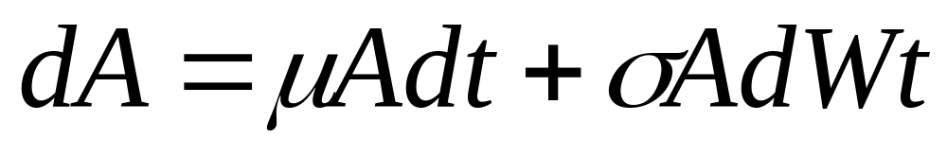
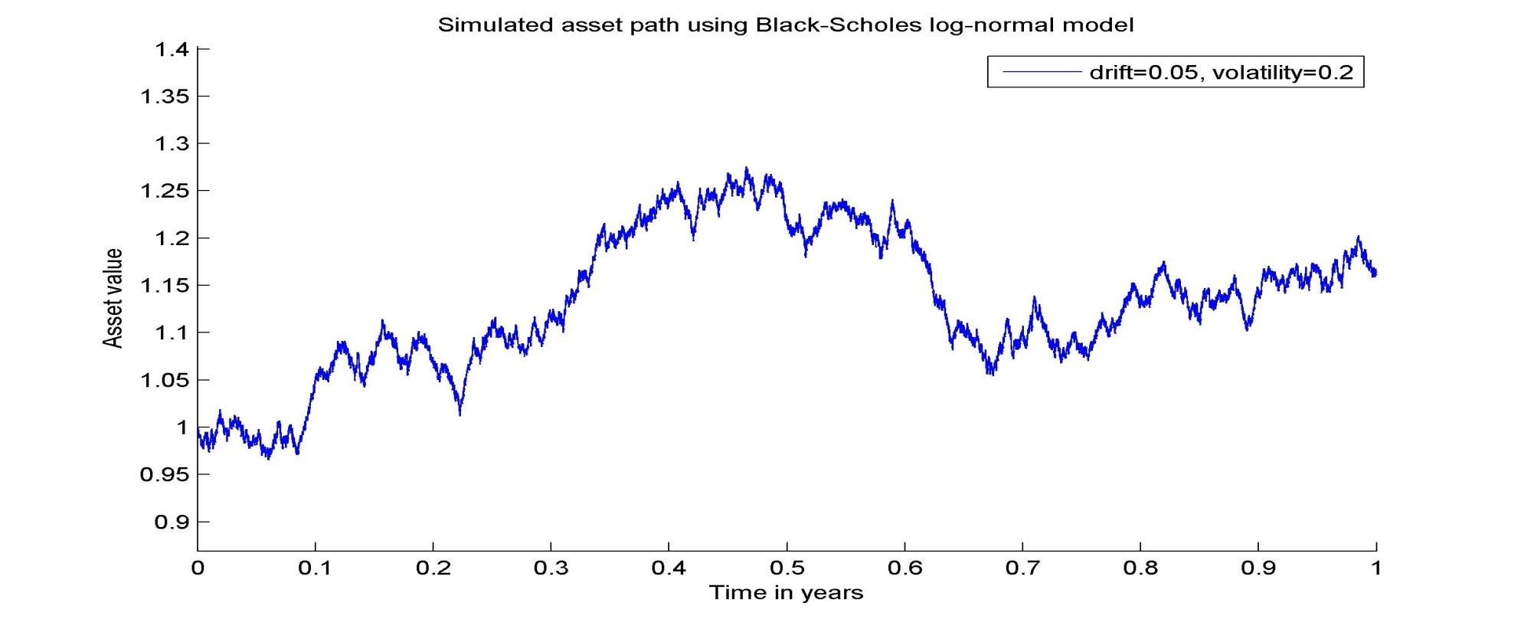
In 1973, Black and Scholes suggested that changes in asset values could be modelled using a log-normal distribution.
Notes:
I’ll explain here that mu and sigma are constant throughout time, and that Wt is a standard Brownian motion, which simulates the randomness in the price changes.

Slide 6

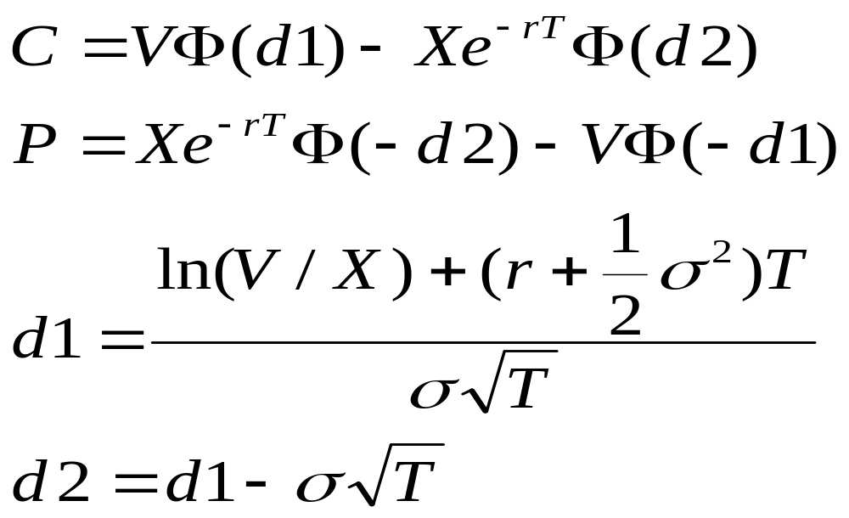
This allowed them to develop simple analytical option pricing formulas.
Asset value and volatility are important parameters.

Slide 7

Black and Scholes realised that option pricing theory could be applied to the claims to assets of a company!
Previously, asset value of a firm taken to be the literal sum of the equity and it’s debt.
Instead, BS say risky bond investors hold options on the assets, the cost of which is decided by the volatility of the asset value process.
Equity holders also have an option. They receive anything left over once all debt is paid off.

Slide 8

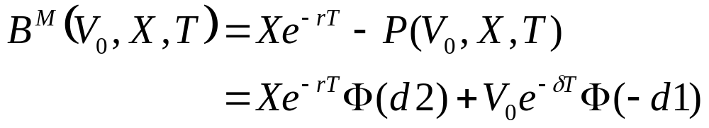
Merton used option pricing formula of Black-Scholes to come up with his bond pricing formula:

Slide 9

Assumes the following restrictions hold:
  Constant risk-free interest rate
  Asset volatility is constant through time
  Very simple firm structure made up of equity and a single issue of debt.
  A firm can only go bankrupt on the day the bond is due, not before. If they are unable to pay their debts on the day of maturity, bond holders take over the firm immediately.
  Taxes and transaction costs do not apply.
  Etc etc…
Notes:
Talk about BS option pricing formula and assumptions

Slide 10
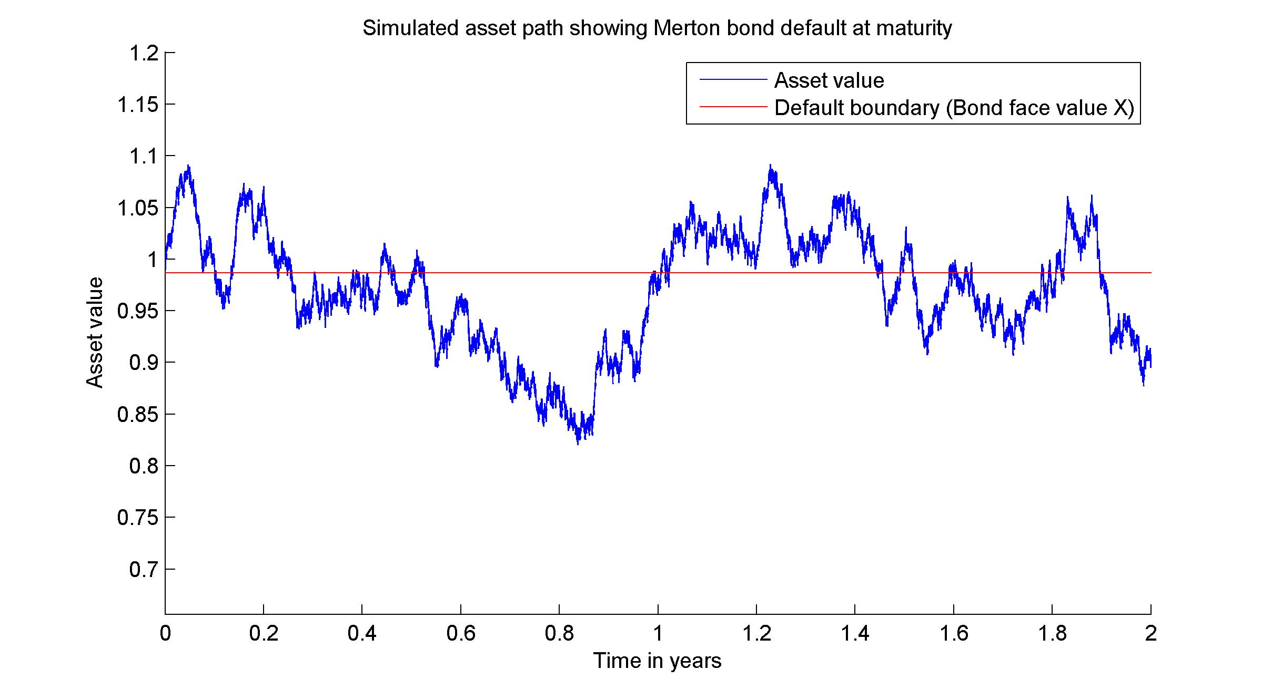
What does this mean? At maturity, this bond will default because assets are lower than debts:
Notes:
Add a graph of a simulated asset price, overlaid with a line representing total liabilities… if asset value is below liabilities at bond maturity, then default occurs…

Slide 11

The previous assumptions are overly simple in comparison to the real world
  asset volatility is not constant
  interest rates are not constant
  firms often have very complex capital structures
    Different bonds with different maturities and seniorities on issue
    Other, non-tradeable liabilities such as employee benefits
    Mix of short and long term debts… etc etc
  firms are may go broke well before the maturity date of their debt

Slide 12
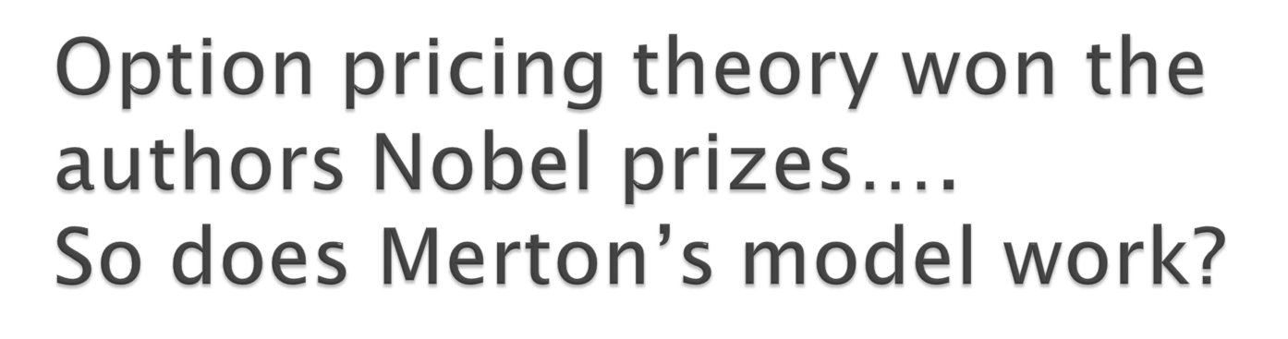

Slide 13
NO

Slide 14

After 10 years of discussion, attempts to test the model against actual market prices of risky bonds suggested that more work was required…
Bond prices are very sensitive to the discount rate applied. Discount rates for different levels of risk are often measured down to fractions of a percent. Existing models fail to predict the discount rate accurately.

Slide 15

Dozens of new structural models have been proposed in an attempt to rectify the apparent issues with Merton’s original attempt.
Incorporate taxes, early default, optimal leverage ratios, stochastic interest rates, etc.
All add to the complexity of Merton’s original attempt.

Slide 16
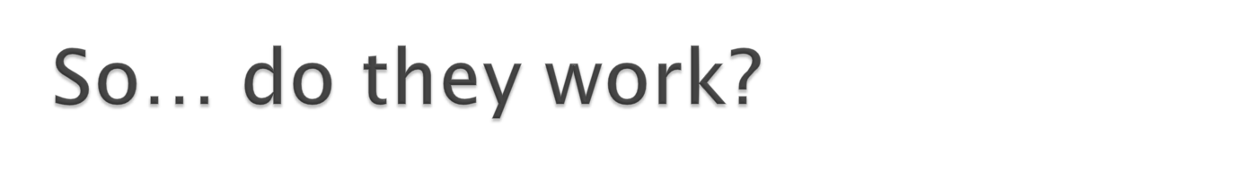

Slide 17
No….
and no-one is winning Nobel prizes for them either.

Slide 18
Empirical studies as late as 2004 find that the structural bond pricing models still do not predict market bond prices sufficiently well enough to be of any practical use.
But there is hope, for a new idea has been proposed….

Slide 19
Early structural modelling attempts assume that the value of the company assets is observable by taking a book value of debt, and adding that to the market value of equity.
But recent studies suggest that this is a biased approach, which overestimates the value of a firm, and so underestimates its riskiness.
So the failure of structural models thus far may be more to do with the methods of producing the input parameters for the models, than with the models themselves.

Slide 20

What is it? Given a sample of observed outcomes, and an assumed probability distribution, MLE is a technique used to guess the parameters most likely to have produced the observed outcomes.
That is, instead of taking a probability distribution with known input parameters and calculating the probability of an outcome, MLE is effectively working in reverse.

Slide 21
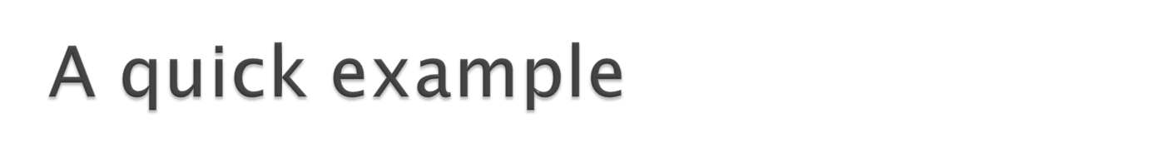
Suppose we take a coin, flip it 10 times and observe 8H and 2T.
It is entirely possible that our coin is completely fair, and that random chance has resulted in our observed outcome.
However, it more likely that our 8H came about because of a bias in the coin. MLE is used to estimate the most likely bias value to have produced our observed outcome.

Slide 22
Take daily observations for the price of equity, think of it as an option.
Can invert the option pricing function to calculate implied asset values…
Use MLE on the transitional probability distribution function of the option to arrive at an implied asset value.
We take log-likelihood functions, trying different parameter values for asset drift and volatility.
Maximise the output to find the most likely values that would have made the asset value evolve according to observations.
We then see if these improved asset dynamics estimates improve the performance of our structural bond pricing models.

Slide 23
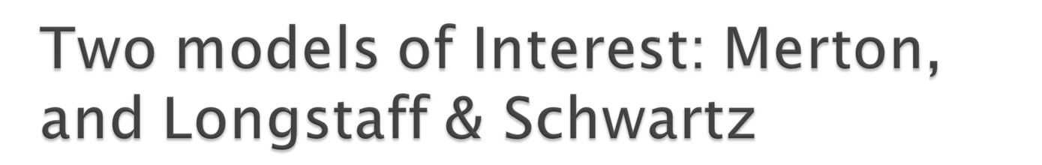
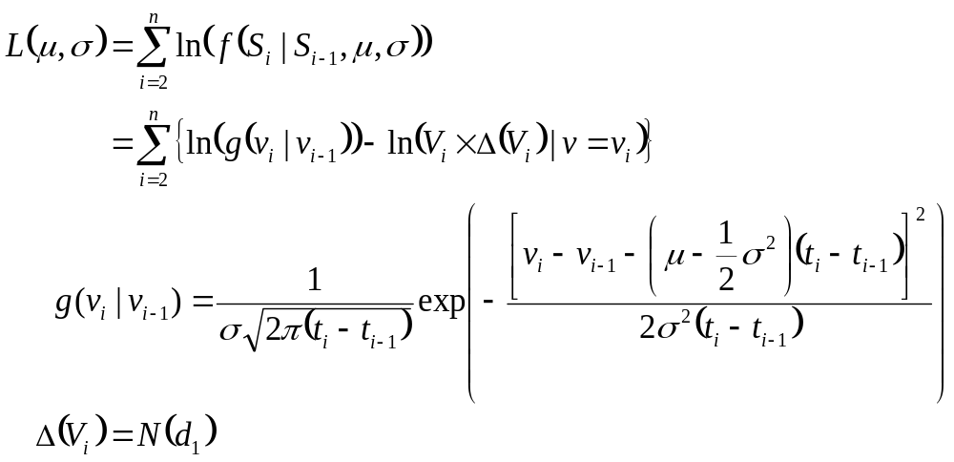
Duan showed in 1994 that the log-likelihood function for Merton is:
Notes:
g() is the transitional density function

Slide 24

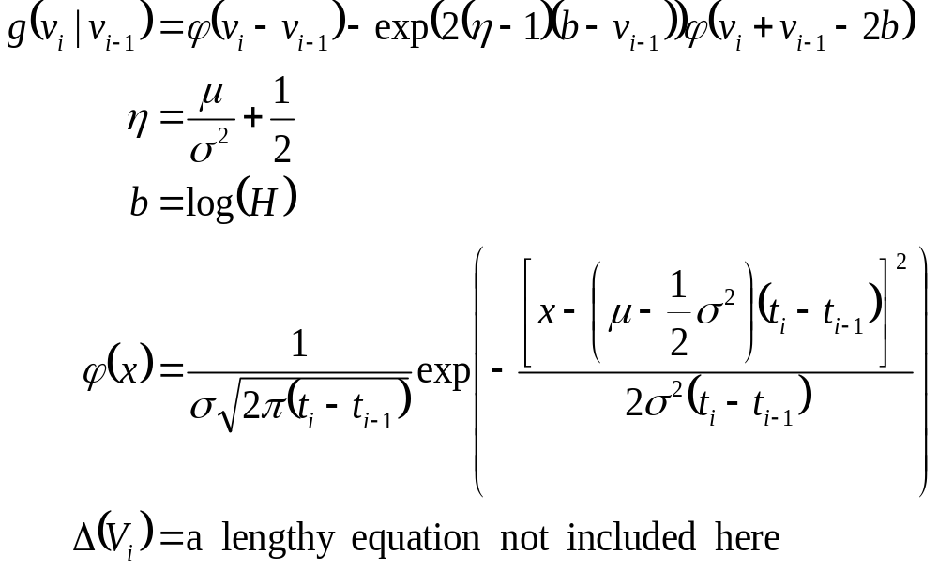
Li and Wong derive the transitional density function g(.) for the LS model as:

Slide 25
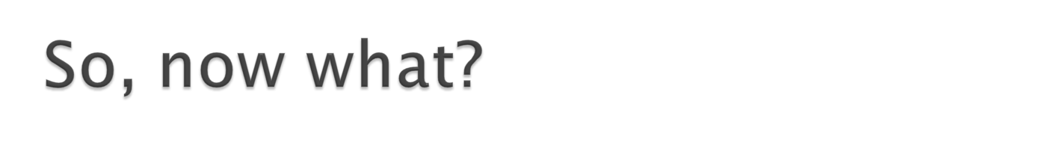
Take the log-likelihood functions, and apply a lengthy numerical optimisation process so that the conditions match each of our market observations conditionally. We are able to back out our implied asset volatility estimates.
And what do we get?

Slide 26
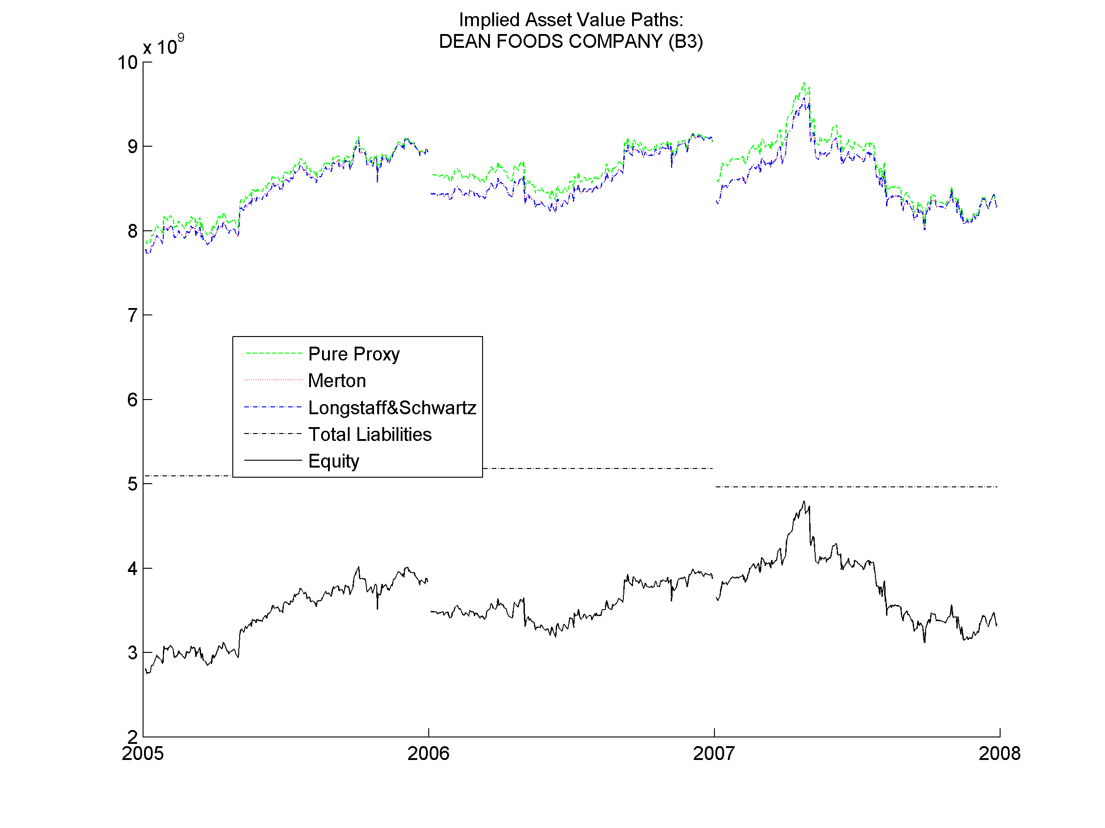

Slide 27
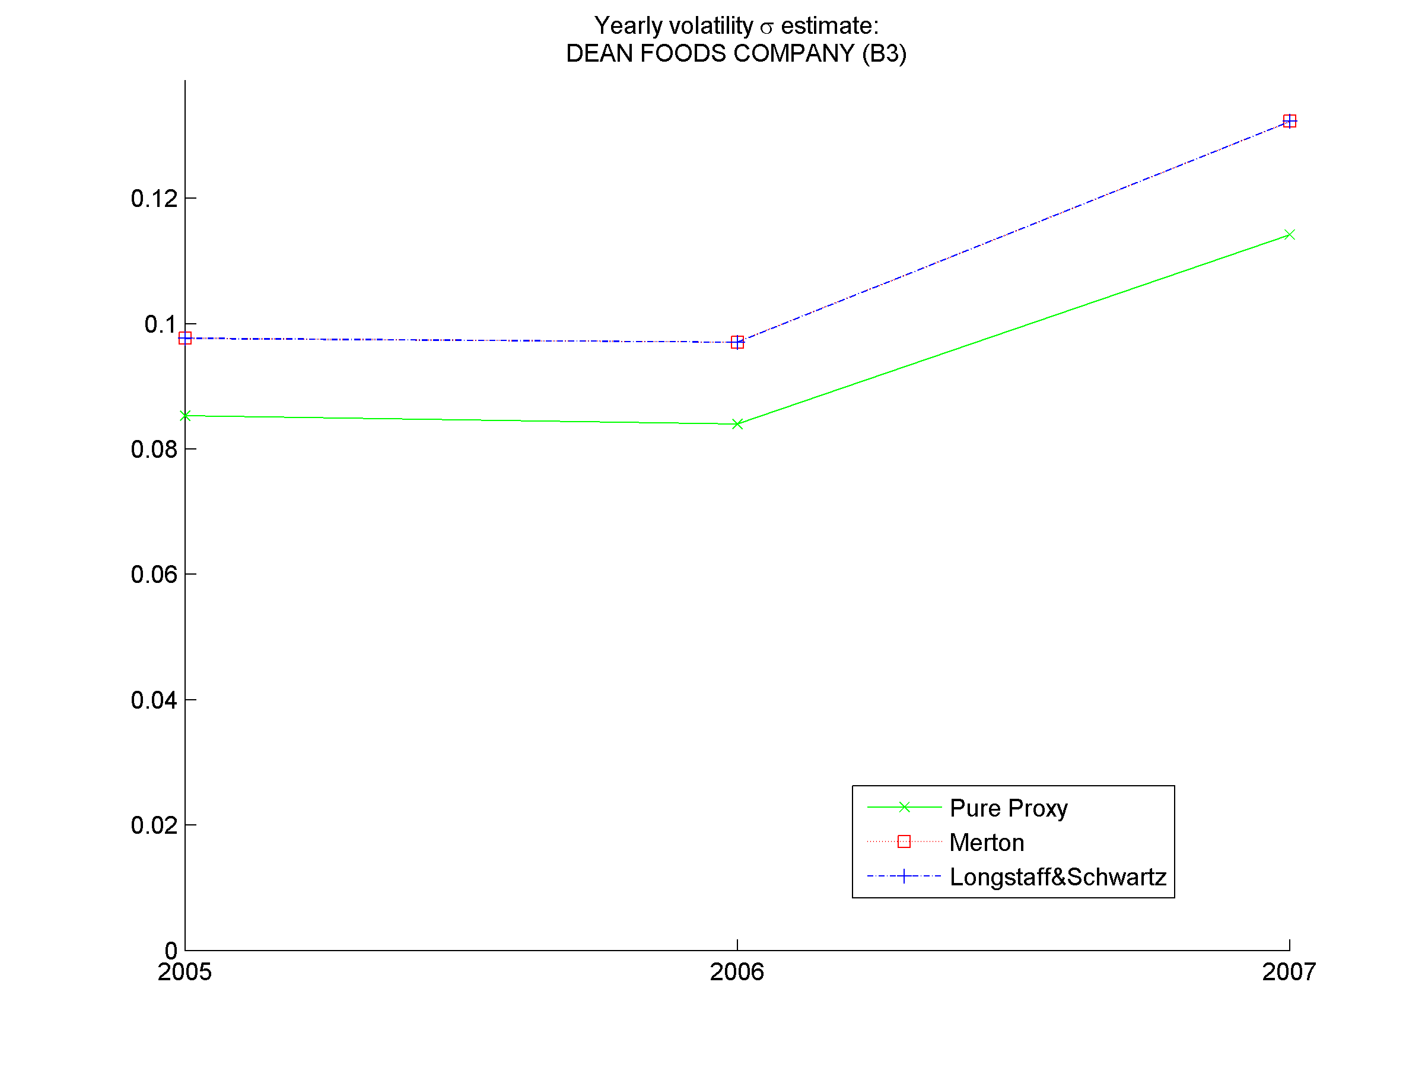
Asset volatility estimates are on average, about 10% higher using MLE

Slide 28
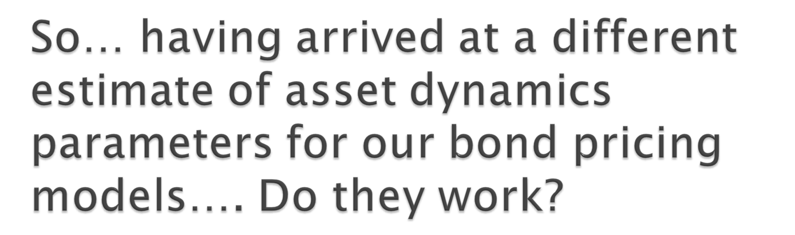

Slide 29
No…

Slide 30
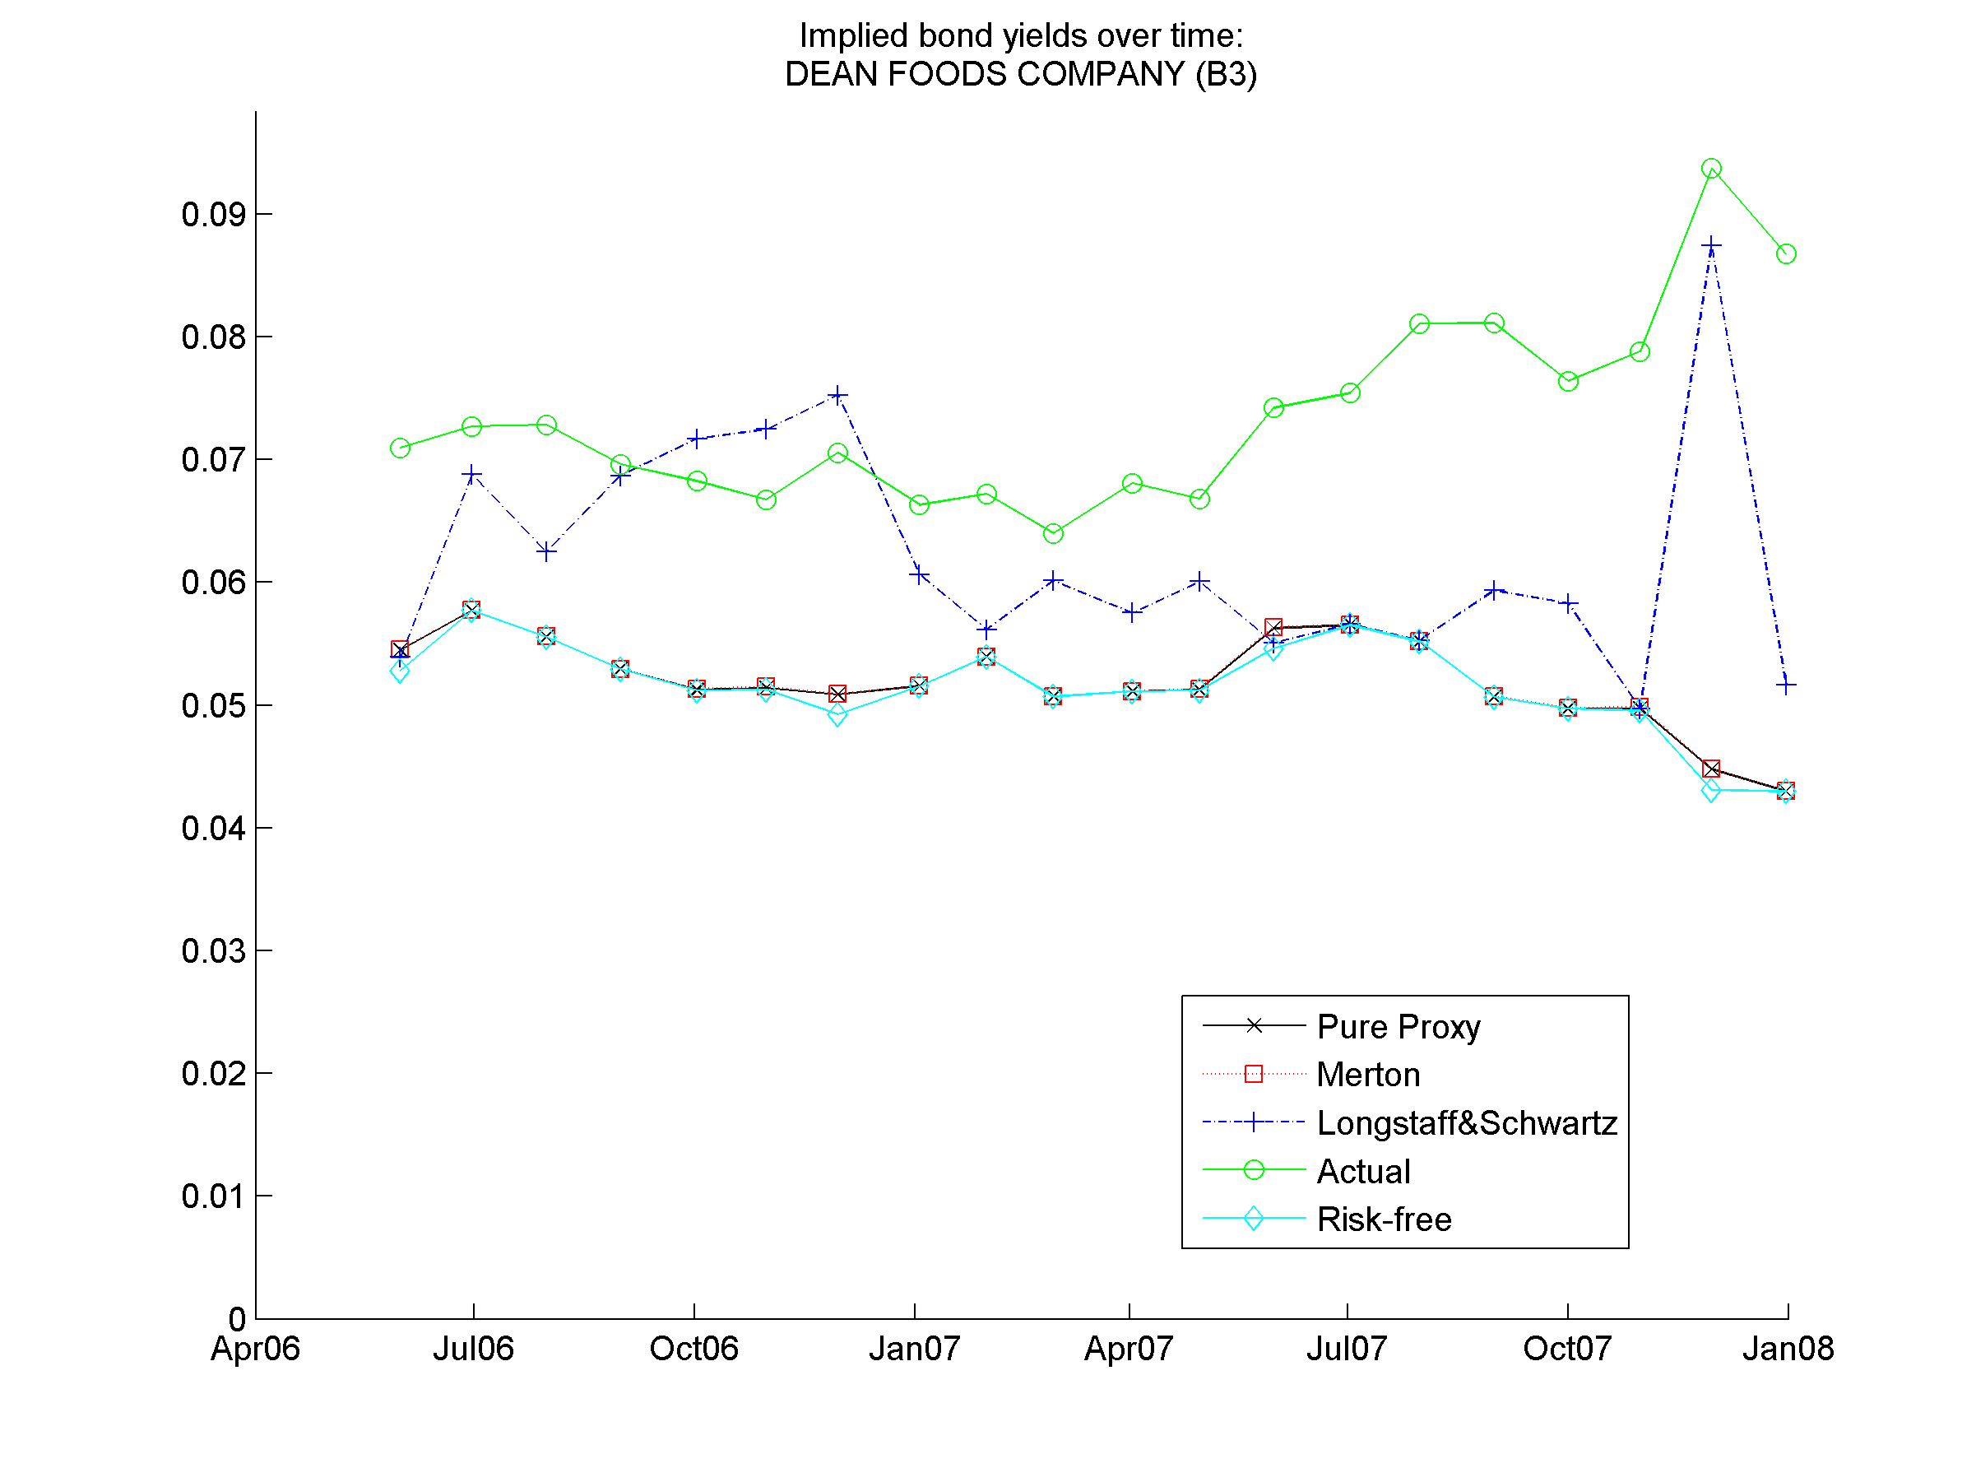

Slide 31

We looked at structural bond pricing models and the rationale behind their use.
We discussed the problem of estimating input parameters for the models, and using MLE to improve our estimates.
I find that the models still fail to accurately predict market prices of risky debt. This suggests that there are still fundamental flaws in the current generations of structural bond pricing models that severely limit practical application.

